Slide 1
Regression

Slide 2
Topics
Get, load and show data
Create a test set
Stratified Sampling
Exploration set
Correlations
Data cleaning
Handling categorical attributes
Custom transformers
Feature scaling
Pipelines
Select and train a model
Cross-Validation
Save the model
Fine-Tuning
Evaluation

Slide 3
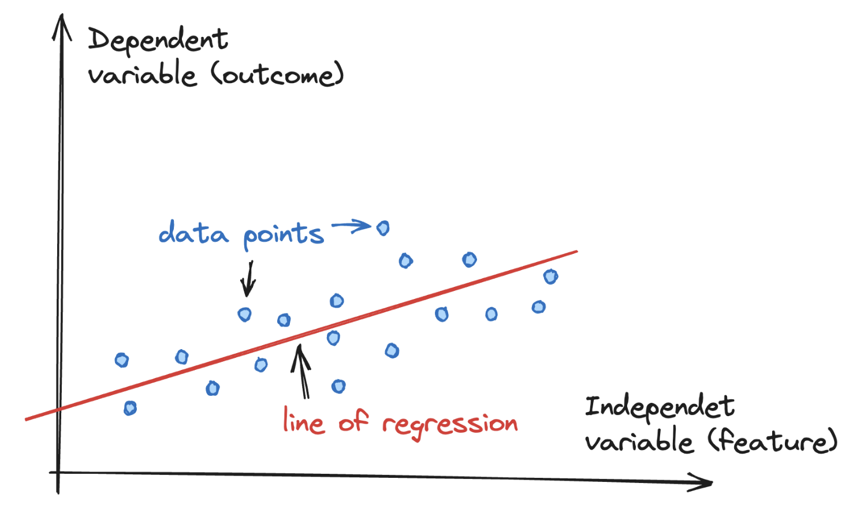
Definition
Regression is a method for understanding the relationship between independent variables (features) and a dependent variable (outcome)
Outcomes can then be predicted once the relationship between independent and dependent variables has been estimated.
Generally, involves searching for a “line” of best fit through the data points
distance between each point and the line is minimised to achieve the best fit line

Slide 4
Get the data
In ML projects we will spend a large fraction of or time acquiring, cleaning, and transforming data
typically, data would be available in a database and spread across multiple tables/documents/files
first, we need to familiarize ourself with the data schema
As a running example, we use California census data to build a model of housing prices in the state
data includes metrics (population, median income, and median housing price)
block groups (districts) are the smallest geographical unit
model should learn from this data and predict the median housing price
It is always preferable to create a small functions to download files and decompress it
it is useful if data changes regularly: we can use the function to fetch the latest data
automating the process of fetching the data is also useful
try to automate as much as possible!

Slide 5

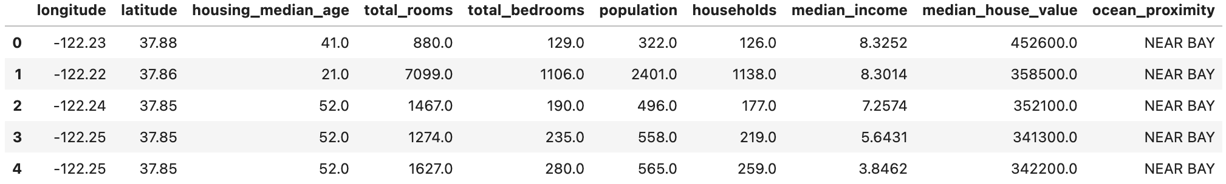
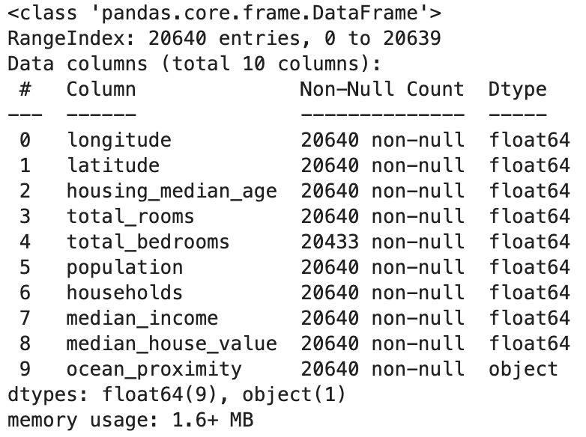
Load the data (1)
We can look at the first rows of data:
It is useful to get a quick description
total number of rows, attribute types, number of nonnull values

Slide 6
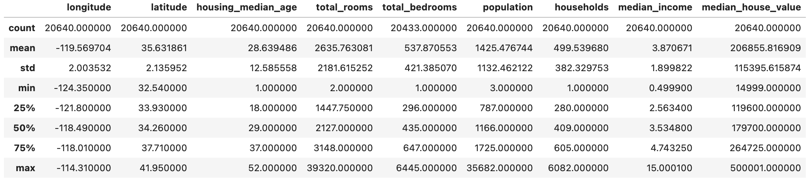
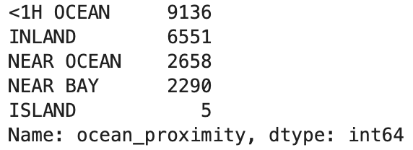
Load the data (2)
A summary of the numerical attributes can provide some ideas
We can get information about categorical attribute by counting elements on each category:

Slide 7
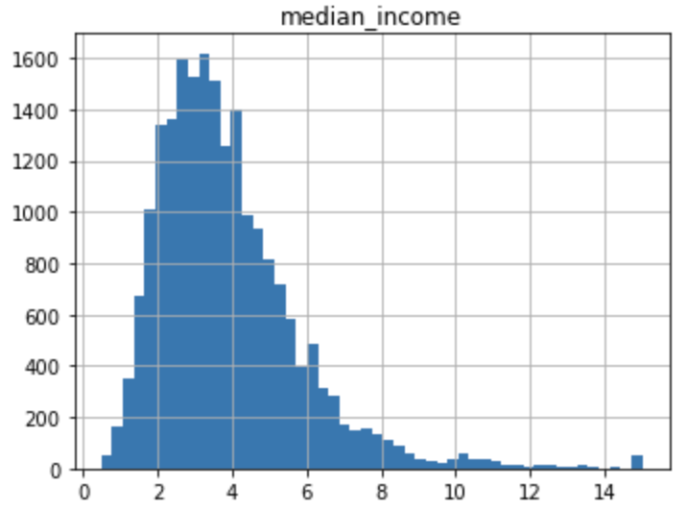
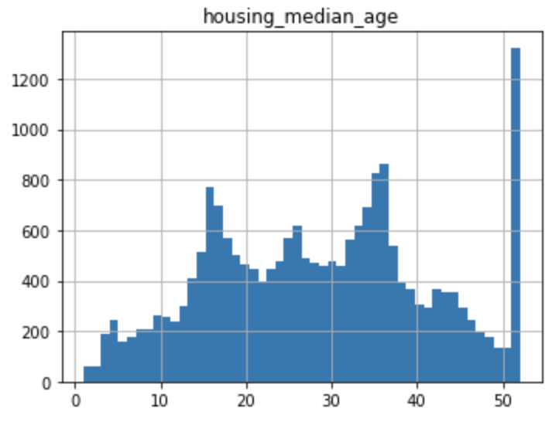
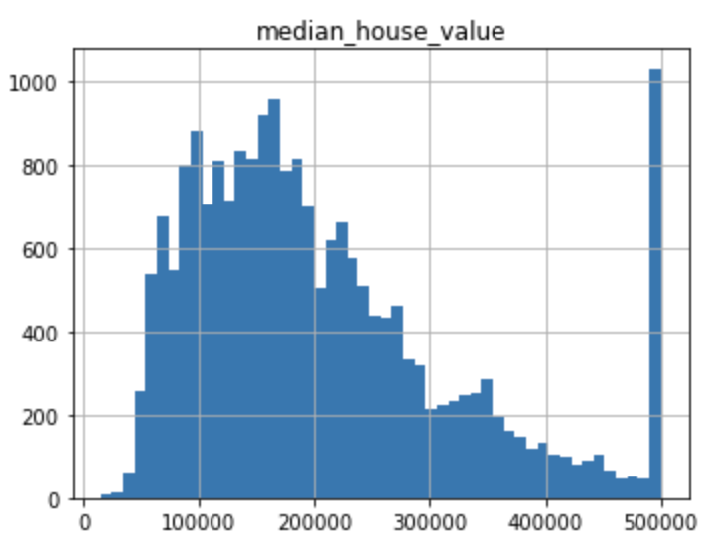
Show data
To get a feel of the type of data we plot a histogram for numerical attributes
There are a few things we might notice in these histograms:
“median income” is not expressed in dollars and it has been scaled and capped at 15 for higher median incomes
"housing median age" and "median house value" were capped
may be a problem since one is the target attribute
algorithm may learn that prices never go beyond that limit
two options: collect proper labels, remove those districts
attributes have very different scales
many histograms are tail-heavy
this may make it a bit harder for some ML algorithms to detect patterns
Working with pre-processed attributes is common in ML
it is not necessarily a problem
but we should try to understand how the data was computed

Slide 8
Create a test set (1)
A common danger in machine learning is overfitting
remind: performing well on the training data, but generalizing poorly to any new data
learning noise in the data, or learning to identify specific inputs rather than whatever factors are actually predictive
The other side of this is underfitting
remind : a model that doesn’t perform well even on the training data
model isn’t good enough and keep looking for a better one
Fundamental approach: using different data to train and to test the model
before looking at the data any further, we need to create a test set, put it aside, and never look at it!
our brain is an amazing pattern detection system: it is highly prone to overfitting
if we look at the test set, we may notice interesting pattern in the test data that leads us to select a particular kind of model
data snooping bias

Slide 9
Create a test set (2)
Creating a test set is simple
pick some instances randomly (typically 20%) of the dataset and set them aside
This works, but it is not perfect:
if we run the program again, it will generate a different test set
over time, we will get to see the whole dataset, which is what we want to avoid
Solutions
save the test set on the first run and then load it in subsequent runs
set the random number generator seed so it always generates the same indices
these solutions will break next time we fetch an updated dataset
Stable train/test split
use each instance identifier to decide whether or not it should go in the test set
compute a hash of each instance identifier
put instances in test set if hash is lower than 20% of the maximum hash value
test set will remain consistent across multiple runs, even if we refresh the dataset

Slide 10
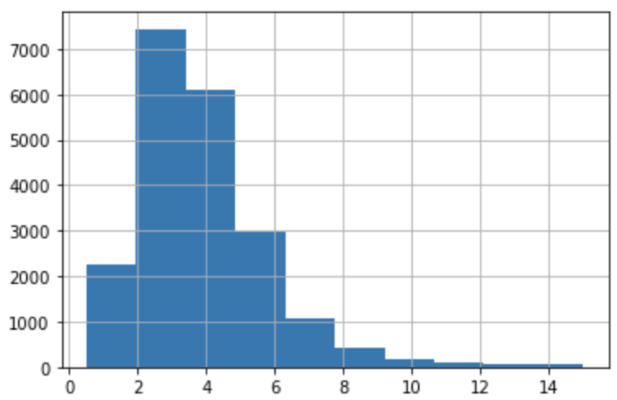
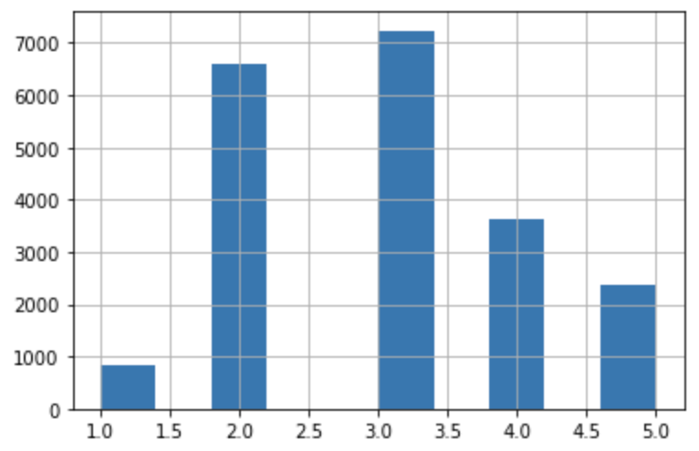
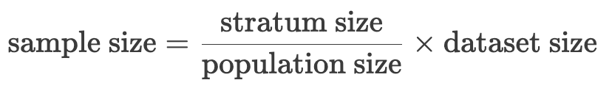
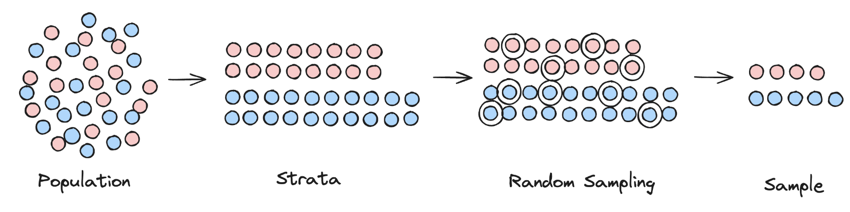
Stratified Sampling (1)
So far we have considered purely random sampling methods
Risk of introducing a significant sampling bias
look at the histogram of "median income"
we want to ensure that test set is representative of the various various “categories” of incomes
we need to create a new category attribute
bins=[0., 1.5, 3.0, 4.5, 6., np.inf]
We can now use stratified sampling
divide population into homogeneous subgroups (strata)
sample from strata in a proportional way

Slide 11
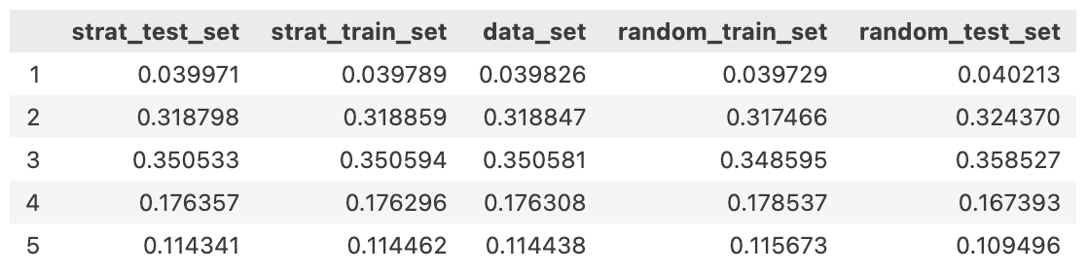
Stratified Sampling (2)
WE splits the dataset into training and testing sets using the two different methods
We calculates the proportions of each category ("income_cat") in each dataset
stratified train/test sets, random train/test sets, and original dataset)
Set generated using stratified sampling has income category proportions almost identical to those in the full dataset
whereas sets generated using purely random sampling is skewed.

Slide 12
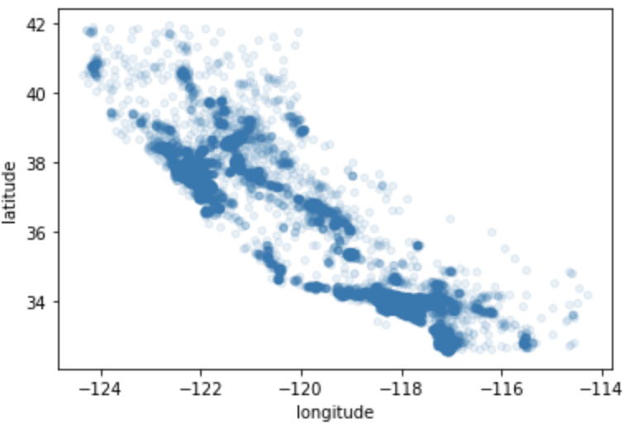
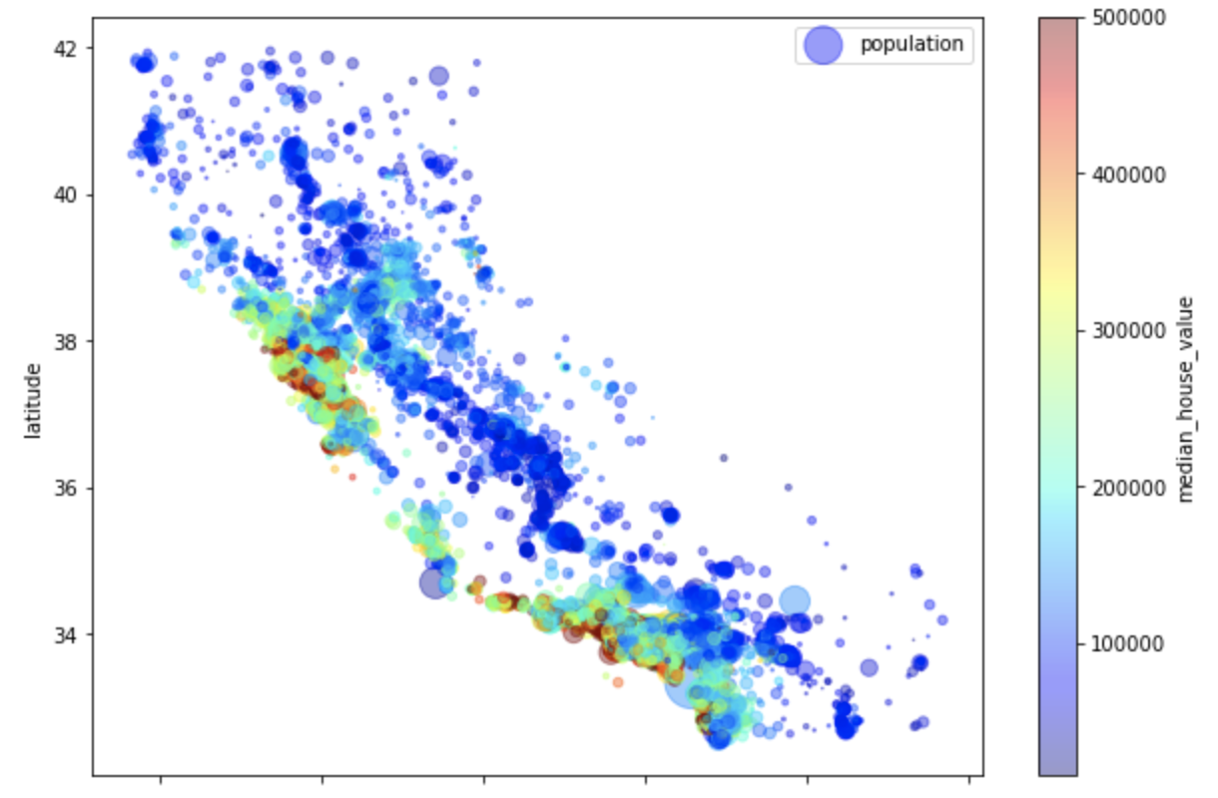
Exploration set
If the training set is very large, we may want to sample an exploration set
to make manipulations easy and fast
We have geographical information
latitude and longitude
use scatterplot of all districts to visualize patterns
Use attributes like circle colour and size
radius to represent the population
colour to represents the price
Housing prices are very related to
the location (e.g., close to the ocean)
the population density
A clustering algorithm can be useful for detecting the main clusters and for adding new features

Slide 13
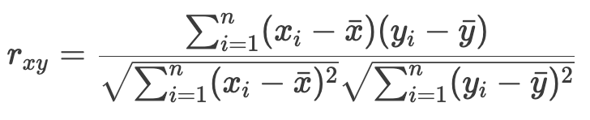
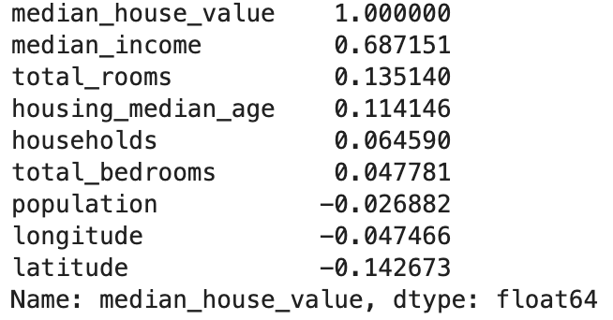
Correlations (1)
Since the dataset is not too large, we can easily compute standard correlation coefficient between every pair of attributes
coefficient ranges from –1 to 1
close to 1 means a strong positive correlation
close to –1 means a strong negative correlation
close to 0 mean no linear correlation
In our dataset we can notice
"median house value" tends to go up when the "median income" goes up
a small negative correlation with "latitude"
Plot every numerical attribute against every other numerical attribute
focus on a few promising attributes that seem most correlated

Slide 14
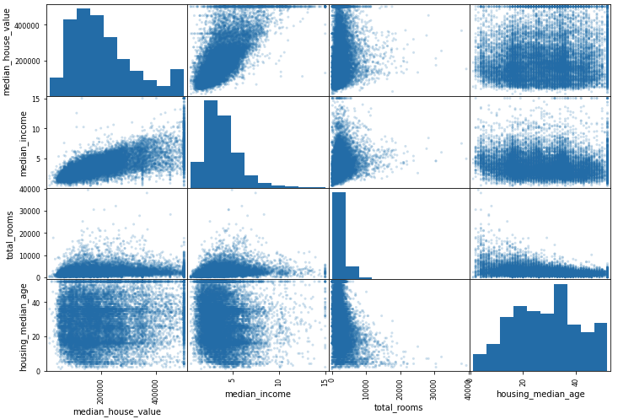
Correlations (2)
The most promising attribute is the "median income"

Slide 15
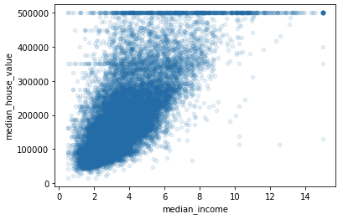
Correlations (3)
The correlation is strong
notice the upward trend
points are not too dispersed
The price cap is clearly visible
horizontal line at the top
The plot reveals other less obvious straight horizontal lines
we may remove the corresponding districts to prevent algorithms from learning these data quirks
However, correlation coefficient only measures linear correlations and completely miss out nonlinear relationships

Slide 16
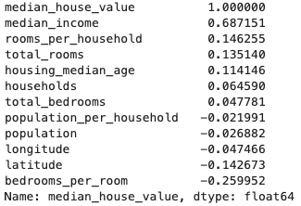
Attribute combinations
We can try out various attribute combinations
"total number of rooms" is not very useful if we don’t know how many households there are
we want number of "rooms per household”
"total number of bedrooms" is not very useful
we want to compare it to the number of rooms
“population per household” seems interesting
Notice:
"bedrooms_per_room" is much more correlated than the total number of rooms or bedrooms
apparently houses with a lower bedroom/room ratio tend to be more expensive
“rooms per household” is also more informative than the total number of rooms
the larger the houses, the more expensive they are
This is an iterative process
once we get a prototype up and running, we can analyse its output to gain more insights and come back to the exploration step

Slide 17
Data cleaning
We should write functions
to reproduce transformations easily on any dataset
to transform the new data in production before feeding it to the model
automate!
First revert to a clean training set and separate the predictors and the labels
Several algorithms cannot work with missing features
delete the corresponding sample
remove the whole attribute
set the missing values to some value (zero, the mean, the median, etc.)
In the example, only "total_bedrooms" had missing values
we cannot be sure that there won’t be any missing values in new data after the system goes live
it is safer to apply the transformation to all the numerical attributes

Slide 18
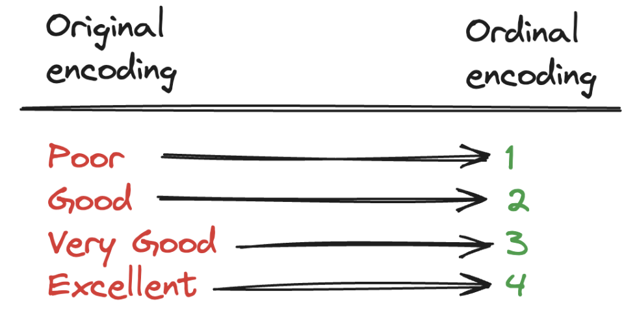
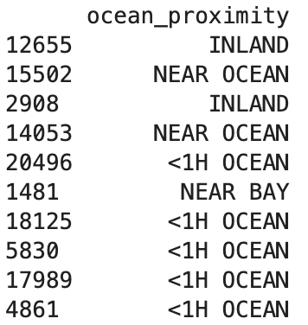
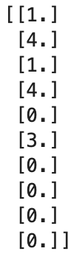
Handling categorical attributes (1)
Attributes not contains arbitrary text, but a limited number of possible values
most algorithms prefer to work with numbers
we need to convert categories from text to numbers
We can do an Ordinal Encoding
In the example, we have the "ocean_proximity" attribute
An issue: algorithms can assume that two nearby values are more similar than two distant values
this may be fine in some cases (ordered categories like “bad” “average” “good”)
not in the general the case (like "ocean_proximity”)

Slide 19
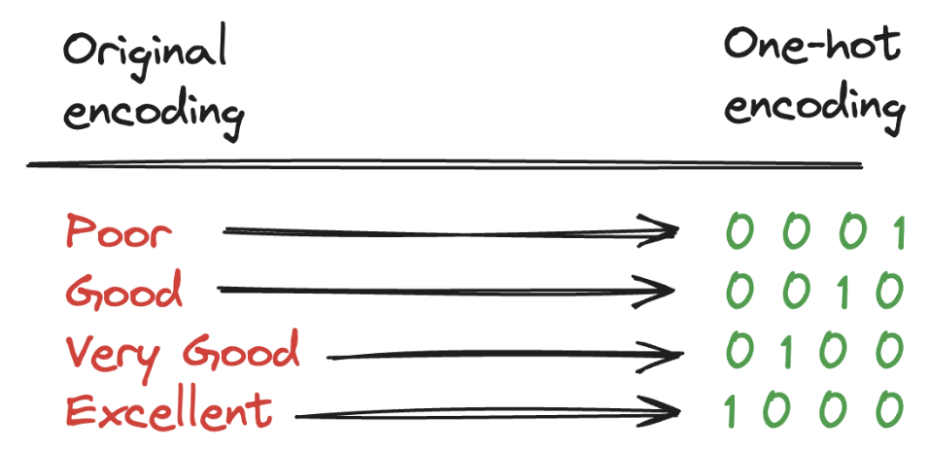
Handling categorical attributes (2)
A common solution is the one-hot encoding
create one binary attribute per category
attributes equal to 1 for the corresponding category and 0 otherwise
One issue: large number of possible categories will result in a large number of input features
this may slow down training and degrade performance
solution: replace categorical input with useful related numerical features
for example, replace “ocean_proximity” with the distance to the ocean

Slide 20
Custom transformers
We can write several transformers
custom clean-up operations
combining specific attributes
…
To work seamlessly with Scikit-Learn, we need to create a class:
add BaseEstimator and TransformerMixin as a base classes
implement fit(): used to calculate the parameters of our custom transformer
Implement transform(): used to apply the actual transformation that our custom transformer intends to do
For example, we can create a transformer to combine attributes
Importance of automation!
more we automate steps, more combinations we can automatically try out
making much more likely that we will find a great combination (saving a lot of time)

Slide 21
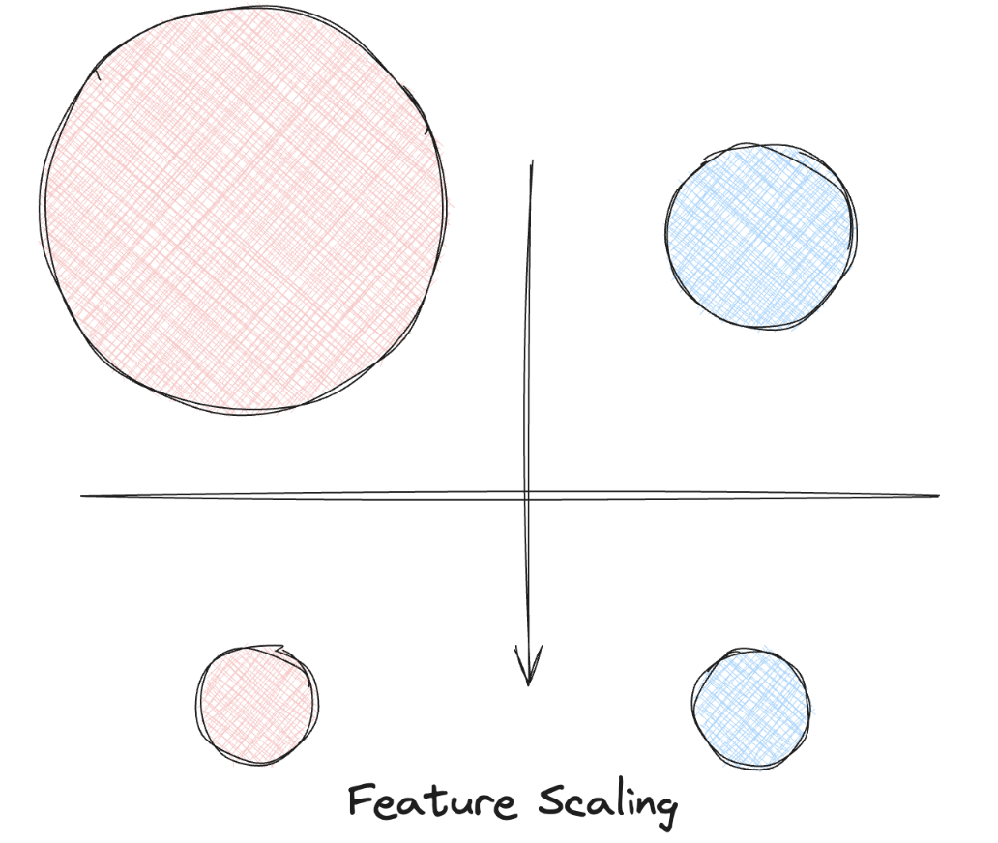
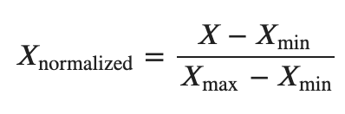
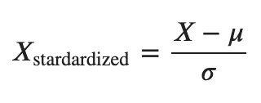
Feature scaling
ML algorithms don’t perform well when the numerical attributes have very different scales
Normalization
values are shifted and rescaled so that they end up ranging from 0 to 1
Standardization
subtracts the mean value and then divides by the standard deviation
so that the resulting distribution has unit variance
does not bound values to a specific range
which may be a problem for some algorithms
it is much less affected by outliers

Slide 22
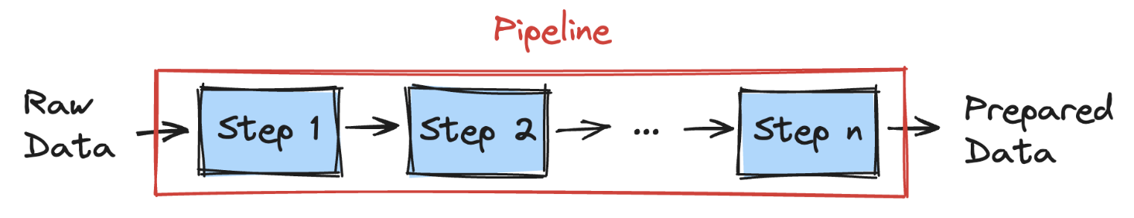
Pipelines
Help with the sequences of transformations
The constructor takes a list of estimators defining a sequence of steps
all estimators must be transformers (must have a fit_transform() method)
When we call the pipeline’s fit() method
it calls fit_transform() sequentially on all transformers
passing the output of each call as the parameter to the next call
The pipeline exposes the same methods as an estimator
Managing "categorical" and "numerical" columns separately it is not convenient
Scikit-Learn introduced the ColumnTransformer for this purpose
the constructor requires a list of tuples
each tuple contains a name of a transformer and a list of names of columns that the transformer should be applied to

Slide 23

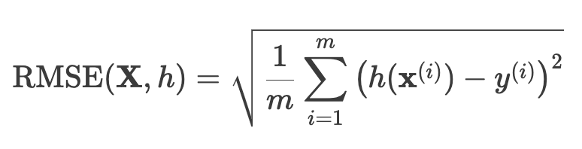
Select and train a model (1)
Recap: we framed the problem, we got the data and explored it, we sampled a training set and a test set, we wrote transformation pipelines to clean up and prepare data for ML
We are now ready to select and train a ML mode
Let’s use as evaluation the Root-Mean-Square Error (RMSE)
a measure of the differences between the real values (y) and the values predicted by the model (h(X))
residuals
on the whole training
First, we train a Linear Regression model
it works, although the predictions are not exactly accurate

Slide 24
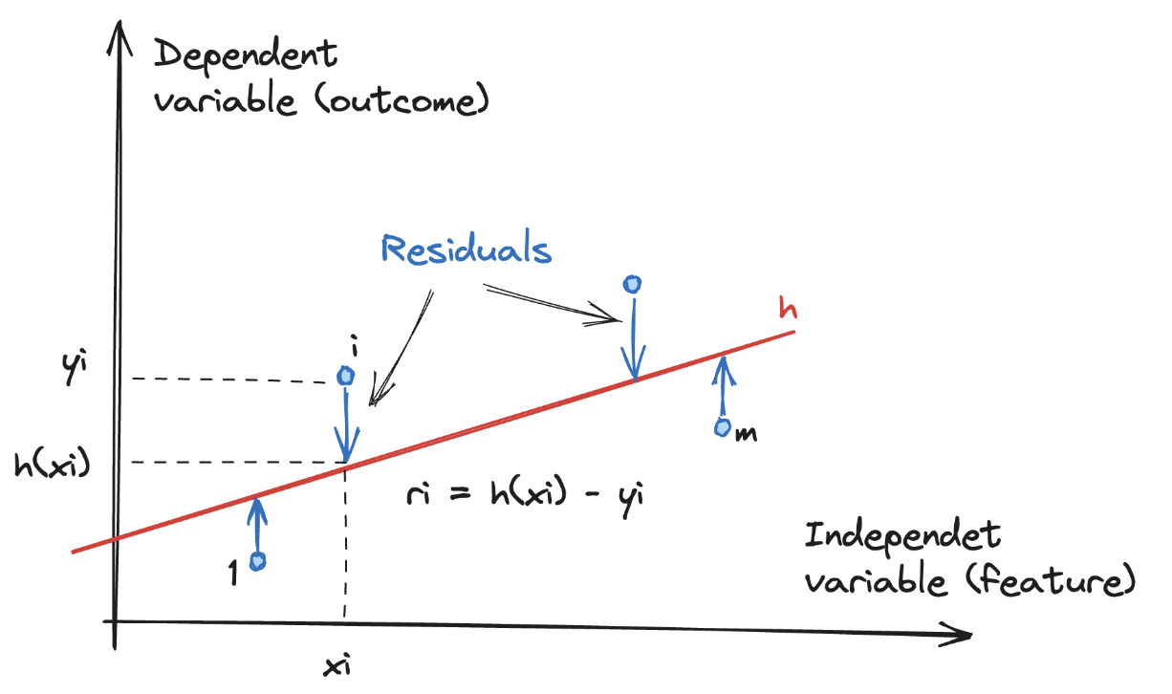
Select and train a model (2)

Slide 25
Select and train a model (3)
In the example, we get high RMSE:
RMSE = 68,000 dollars
most districts range between 120,000 dollars and 265,000 dollars
…the prediction error is not very satisfying
This is an example of a model underfitting the training data
features do not provide enough information to make good predictions
or the model is not powerful enough
The main ways to fix underfitting are
select a more powerful model
feed the training algorithm with better features
reduce the constraints on the model

Slide 26
Select and train a model (4)
We can try a more complex model, like a Decision Tree
RMSE = 0, no error at all?!
could this model really be perfect?
It is much more likely that the model has overfit the data
how can we be sure?
don’t touch the test set until you are ready to launch a model we are confident about
we need to use part of the training set for training and part for model validation!
Before, we try one last model, the Random Forest Regressor
it works by training many Decision Trees on random subsets of the features
then averaging out their predictions (Ensemble Learning)
RMSE = 18700 dollars
it looks like not so good as Decision Tree, but much better that Linear Regressor
We need more information on how to compare models

Slide 27
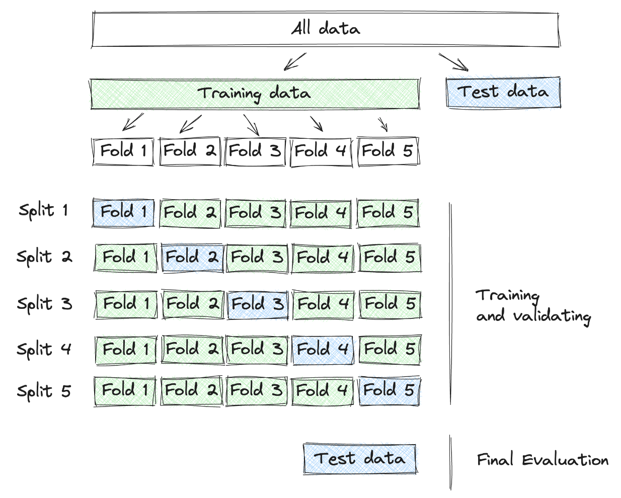
Cross-Validation (1)
Randomly split the training set into K distinct subsets (folds)
Train and evaluate the model N times (on different folds)
pick a fold for evaluation and training on the other (K-1) folds
The result is an array containing the N evaluation scores

Slide 28
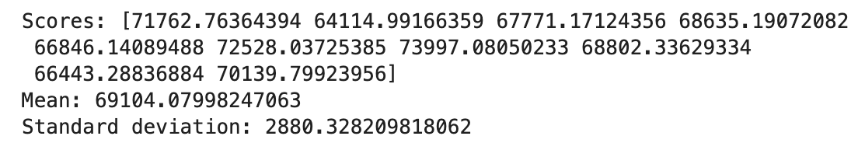
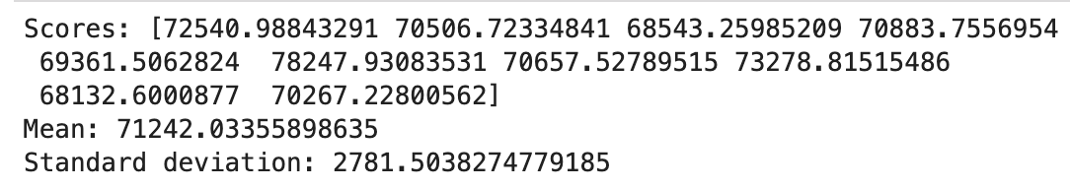
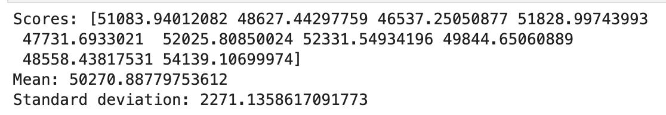
Cross-Validation (2)
The values for the three models are:
Linear Regression
Decision Tree
Random Forest
Notice: cross-validation provides an estimate of the performance and a measure of how precise this estimate is (standard deviation)
Decision Tree doesn’t look as good as it did earlier
it is overfitting so badly that it performs worse than the Linear Regression model
Random Forest looks promising
the score on training set is lower than on validation sets: still overfitting
possible solutions: simplify model, constrain it (regularize), get more training data
Before diving deeper into Random Forests, we should try out many other models from various categories
the goal is to shortlist a few (two to five) promising models

Slide 29
Save the model
We should save every model we experiment with so that we can come back easily to any model we want
make sure to save both the hyperparameters and the trained parameters
as well as cross-validation scores and the actual predictions as well
to easily compare scores across model types, and compare the types of errors they make

Slide 30
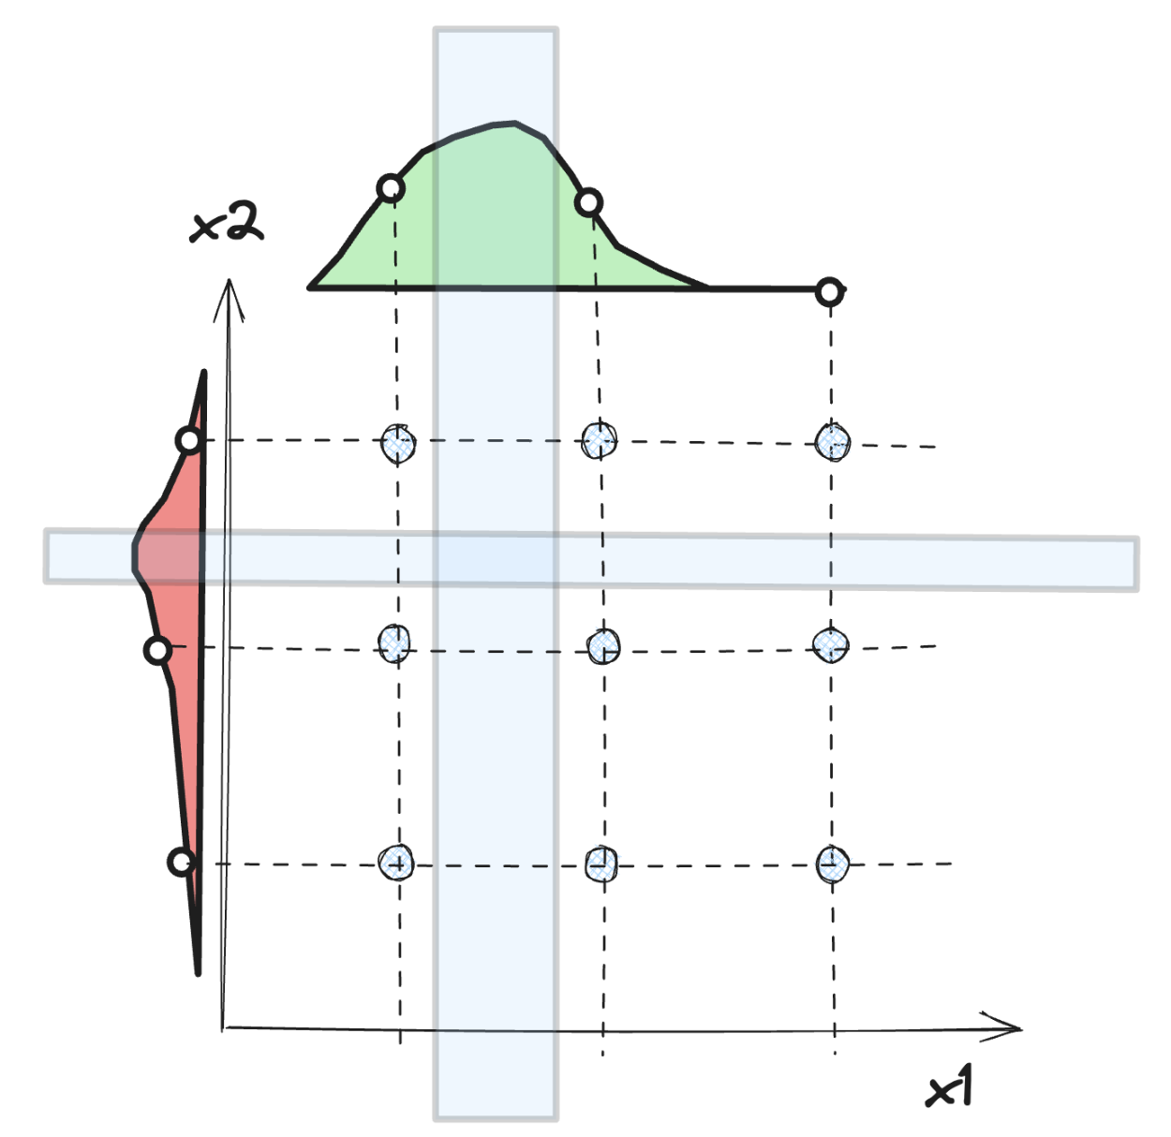
Fine-Tune the model (1)
Assume we have a shortlist of promising models, we need to fine-tune them
set hyperparameters manually, until we find a great combination values
we may not have time to explore many combinations
We can use Grid Search
use a different combination of all the specified hyperparameters and their values
calculate the performance for each combination
select the best value for the hyperparameters
For random forest regressor
the best params are mc_features=6 and n_estimators =30
and the best model has RMSE of 49934 dollars
When we have no idea what value a hyperparameter should have, a simple approach is to try out consecutive powers of 10

Slide 31
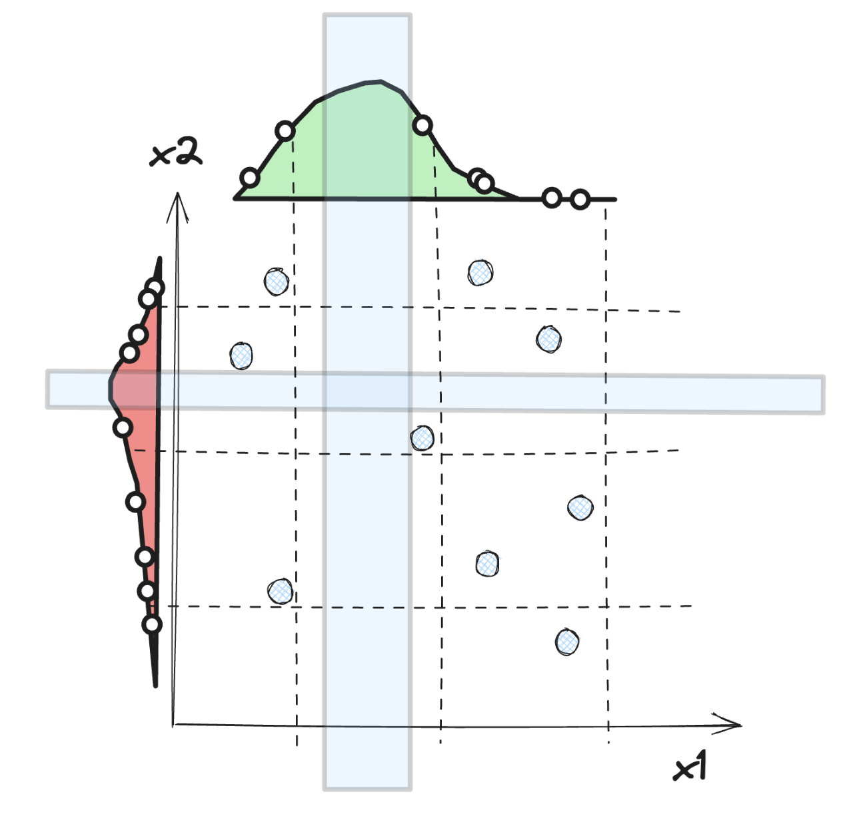
Fine-Tune the model (2)
The grid search approach is fine when we are exploring relatively few combinations
It is often preferable to use Randomized Grid Search
instead of trying all possible combinations, use a random sample
faster exploration of the solution space
control over the computing budget we want to allocate

Slide 32
Evaluation
After tweaking our models for a while, we eventually have a system that performs sufficiently well
Now is the time to evaluate the final model
get the predictors and the labels from the test set
run the full pipeline to transform the test data
evaluate the final model on the test set
The performance will usually be slightly worse than what we measured using cross-validation
the system ends up fine-tuned to perform well on the validation data and will likely not perform as well on unknown datasets
not the case in this example (RMSE=46.109 dollars)
When this happens, we must resist the temptation to tweak the hyperparameters to make the numbers look good on the test set
the improvements would be unlikely to generalize to new data

Slide 33
Exercise
1 - Try a Support Vector Machine regressor (sklearn.svm.SVR), with various hyperparameters such as kernel="linear" (with various values for the C hyperparameter) or kernel="rbf" (with various values for the C and gamma hyperparameters). How does the best SVM predictor perform?
2 - Try replacing GridSearchCV with RandomizedSearchCV

